Slide 1
Working Genius - Introduction
What are you naturally wired to do?
By Mark Irvin, Convene and Clarity Leadership Group, LLC
Ideas based on the Patrick Lencioni’s Table Group

Slide 2
Question 1
Where does leadership development start?
Answer – with knowing yourself…
Do you agree with the following quote?

Slide 3
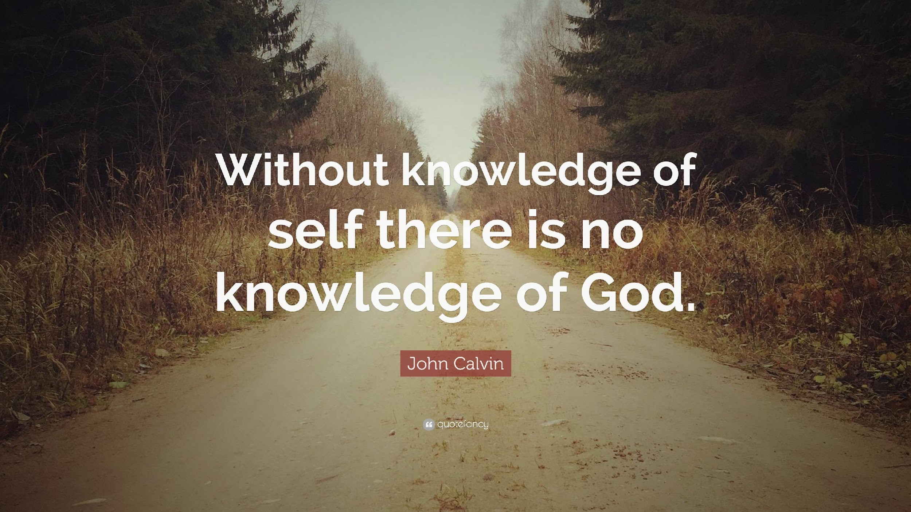

Slide 4
Question 2
Think of something you want to improve in your company right now …
Why is it not improved/solved already?
What is the type of person needed to improve/solve that?
  To what extent is this like you or different than you?

Slide 5
Time to consider
Take a few minutes right now …
  Think of a day that just drained you … What was the context?
  What was a day that you thought was a great day of work. What was that context?
  Think of a task that your team would give you negative feedback on … what task/type of task is that?
Get in groups of 2 (or 3 if needed) and share with each other – 2 mins per person…

Slide 6
More questions …
How many of you have ever heard – “If you love the work you do, you will never work another day in your life.”?

Slide 7
Getting Underneath How I Feel About My Work
Patrick Lencioni – Felt like he was “exhausted and exasperated (at work) on a semi-regular basis” and didn’t get why.
In June of 2020, a colleague asked him, “Why are you like this?”

Slide 8
The Premise
Work feels most fulfilling (and the least draining) when the majority of your time is spent doing tasks/a role that uses the natural wiring – your genius(es) - that God has given you.
We do not all have the same geniuses…
To be a true genius, you not only do it well, but you are passionate about it and when doing it, you are energized.

Slide 9
On your own
Who on this team do you think of as someone who likes to step back and think about what could be?
If you need some new system or process created, who do you go to?
Who do you naturally run your ideas by to help refine them?
Who on this team can get a team aligned in a direction?
Who is great at coming along-side of a task and helping get it done?
Who on this team best helps hold people accountable and pushes things across the finish line?
You can vote for yourself… but also interested in who besides you does this…

Slide 10
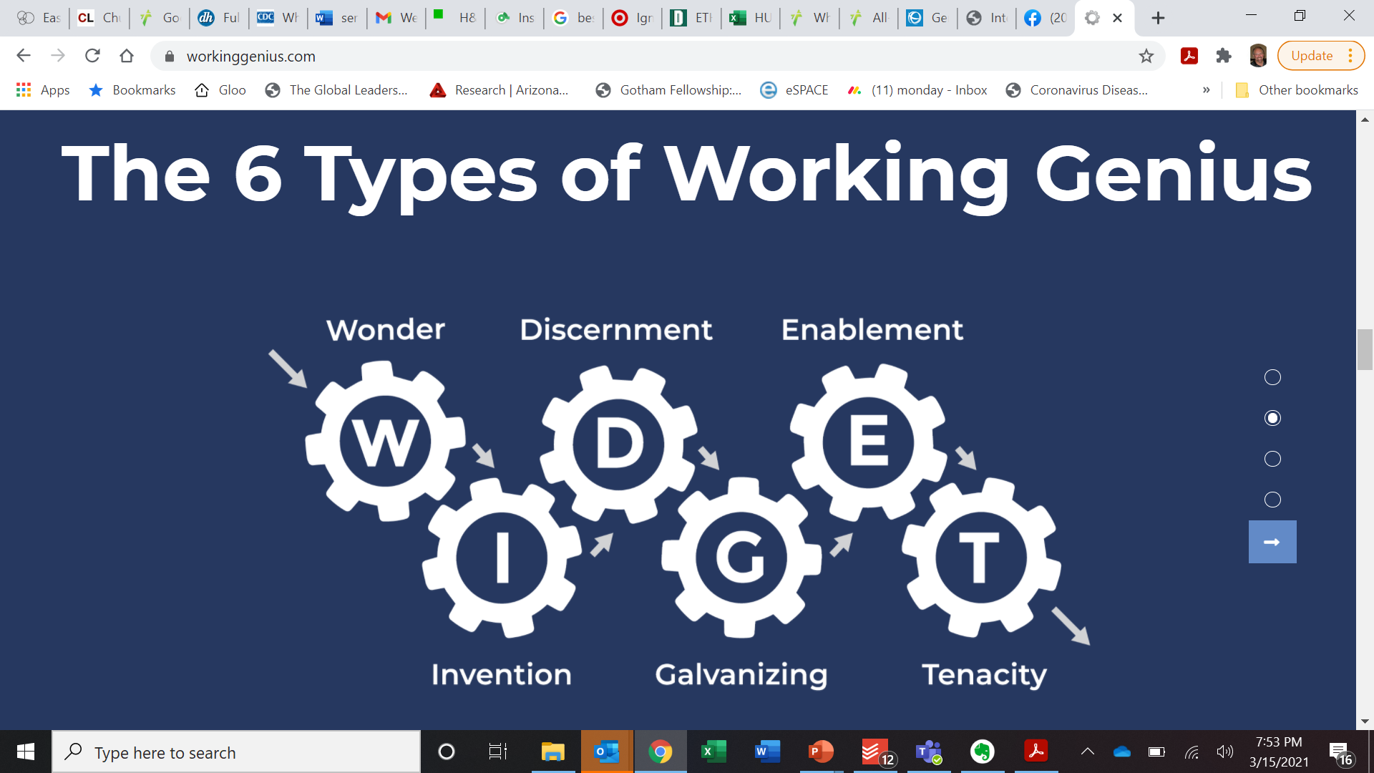

Slide 11
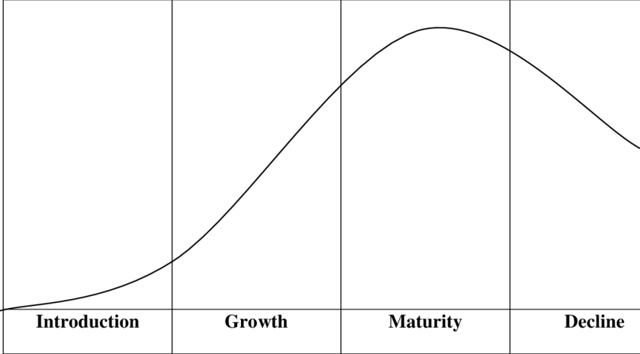
Think of a product “life cycle” or service idea from creation to being fully available

Slide 12
Think 3 phases
IDEATION
ACTIVATION
EXECUTION

Slide 13
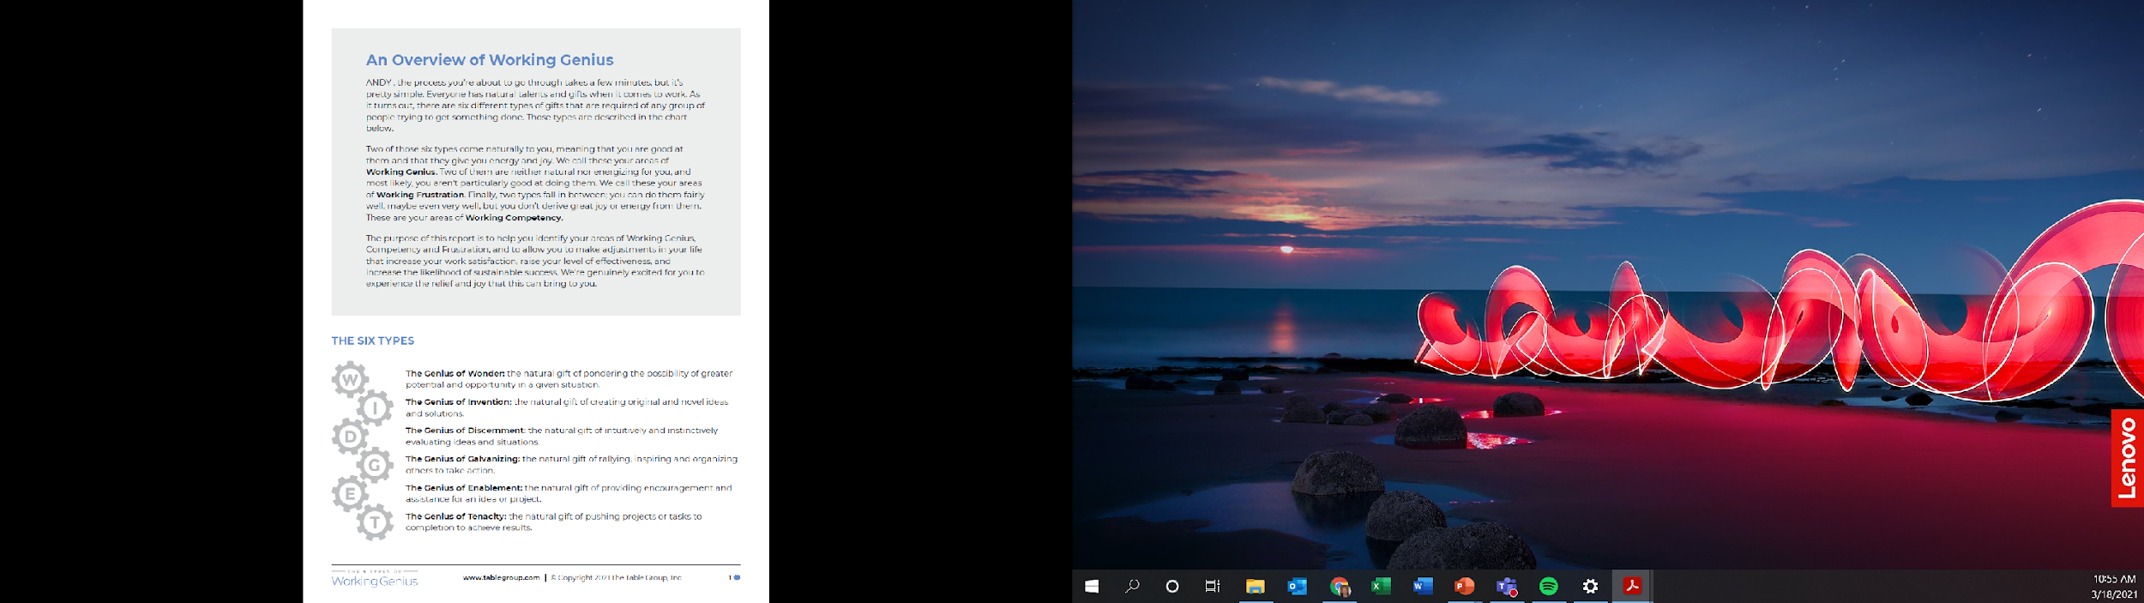

Slide 14
How does this work?
Across hundreds of thousands of results, everyone naturally has
  Category 1: Your Working Geniuses - these top 2 are in your sweet spot.
    You have passion about doing that work, you are good at it, and doing it doesn’t drain you.
    You receive energy and joy when working in these ways.
  Category 2: Your Working competencies – middle 2 of the 6
    You can do them, but if you do them on a sustained basis, they will deplete you.
  Category 3: Your Frustrations – bottom 2 of the 6
    You are not good at these, don’t have passion around them, and they deplete you.
  Think of a stop light – Green, yellow, red types of work/tasks

Slide 15
The Genius of Wonder – Part of Ideation
What you love to do:
  Ask Big picture questions
    How could things be different?
    What would happen if we did ____________?
What you crave…
  Consideration of your wonderings…
What drives you crazy:
  When you don’t have “think time” to ponder…
  When others shoot your ideas down without even giving them a real thought.
  Worst response – “Who cares!”

Slide 16
The Genius of Invention – Part of Ideation
What you love to do:
  Take someone’s wonder idea and help create the path, system, tools to it becoming reality.
  Come up with the initial x things that need to happen to make a change or see an idea come to life.
You crave … freedom to invent
What drives you crazy:
  A team getting stuck and not being able to create change.
  Getting bogged down in not having everything just right.
  Being boxed in for a solution.

Slide 17
The Genius of Discernment – Part of Activation
What drives you crazy:
  When ideation doesn’t go through the process of refinement and bad ideas become reality.
  What you hate - When you give your opinion, and someone says – “prove it” or “where’s the data”.
What you love to do:
  Use your gut to refine ok ideas to make them good or great ideas.
  Find the holes in ideas.
  Because this is part of activation – think through the lens of how will others hear this idea.
What you crave… trust of your gut

Slide 18
The Genius of Galvanizing – Part of Activation
What you love to do:
  Get a group of people together, get them buying into a vision or idea and see them embrace it.
  Have people go to you to help roll out an idea across teams.
What you crave…
  Confirmation of people “getting it”.
What drives you crazy:
  Indifference…
  Apathy …

Slide 19
The Genius of Enabling – Part of Execution
What you love to do:
  See something where someone is struggling and think I can help.
  When you go to help – don’t come up with 10 ways to do it different (invention/discernment) but help in the way the person wants it done.
What you crave … Appreciation, not public recognition
What drives you crazy:
  Watching people struggle when you see how it could get done.
  Silos – I can’t help them because they are not on my team.
  Hate – being ignored or taken for granted

Slide 20
The Genius of Tenacity – Part of Execution
What you love to do:
  See things get fully completed.
  Have a bent to kick butt and say hard to hear things to get things back on track or finished.
What you crave… clarity, permission to do what it takes to get the job done.
What drives you crazy:
  Lack of progress.
  Things ½ done.
  People not following through on commitments.
  Ambiguity on success, plans or goals. Lack of a plan.
  Goal posts being moved in process.

Slide 21

Think in terms of Elevation
Wonder – 30,000 feet view
Invention – 25,000 feet view
Discernment – 20,000 feet view
Galvanizing – 15,000 feet view
Enablement – 10,000 feet view
Tenacity – 500 ft and lower view

Slide 22
How does this fit in with other assessments?
There are 3 main areas that social science looks at and measures on an individual basis-
Intelligent Quotient - How I learn – learning capacity… This is fixed – you can’t change it.
IQ
EQ
Personality
Emotional Quotient – how I respond emotionally to different emotions IN me…AND around me. You can grow in this area.
Personality – think what, why, where, and how I like to interact, work and operate. This is relatively fixed. Often on a continuum.

Slide 23
How does this fit in with other personality assessments?
Working Genius assessment describes the type of work (what) someone excels at
  when used in a team environment can help with who to give certain types of work to.
Every assessment is measuring a continuum of some set of variables.
  EOS – measures visionary vs. integration – similar in some ways to this, but Working Genius breaks integration into additional groupings/buckets
  DISC – measures speed you prefer to operate at (how you like to work) against people focused vs. task focused (what you like to focus on)
  Myers Briggs – Compares how you gather information to solve problems (how) – are you big picture vs detail oriented, how you process information – internal vs. external (how), the lens you look at data through
  Enneagram – gets under your primary motivation – the why or what drives you.

Slide 24
Benefits of Working Genius
A loaded word … Diversity
  The best teams have a broad set of diverse opinions and gifts/abilities
Understanding where your team’s geniuses are can help you set everyone up for better job satisfaction
  This should translate to less churn of your team.
Understanding gaps in Geniuses being represented can help you understand why certain tasks either
  fall on you or
  seem to be constant issues

Slide 25
This Leadership Team
Put spreadsheet of team’s Working Genius Here

Slide 26
What challenges does this create?
Back in your groups of 2 or 3 …
Are you spending over 60% of your time in your geniuses?
What do you notice about where this team is strong?
What do you see about where this team has fewer people with geniuses?
How does having 6 people with frustration of ideation show itself?

Slide 27
Back to our first question –
Think of something you want to improve in your company right now …
What is the type of person that is needed to solve that?
  What part of WIDGET is needed to solve it?
  Is that person on your team?
Given where you are in a life cycle curve, what leadership is needed?
Look at your frustrations…
  Who on your team has geniuses that offset your frustrations?

Slide 28
Thoughts? Questions?
What surprises you about this?
What is helpful about this?
How do you better understand where someone else on your team is coming from?

Slide 29
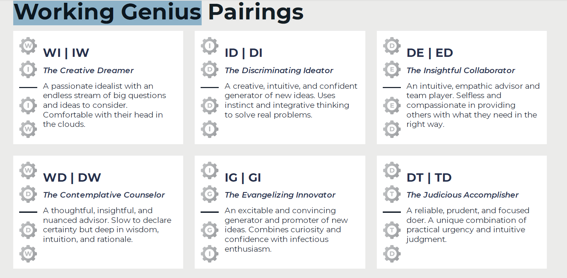
Combining your geniuses:

Slide 30
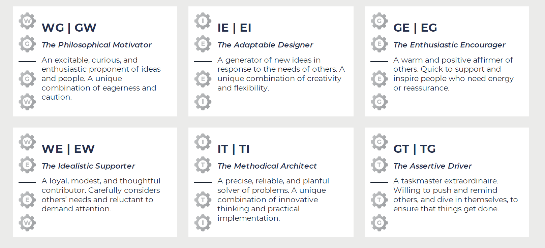
Combining your geniuses:

Slide 31
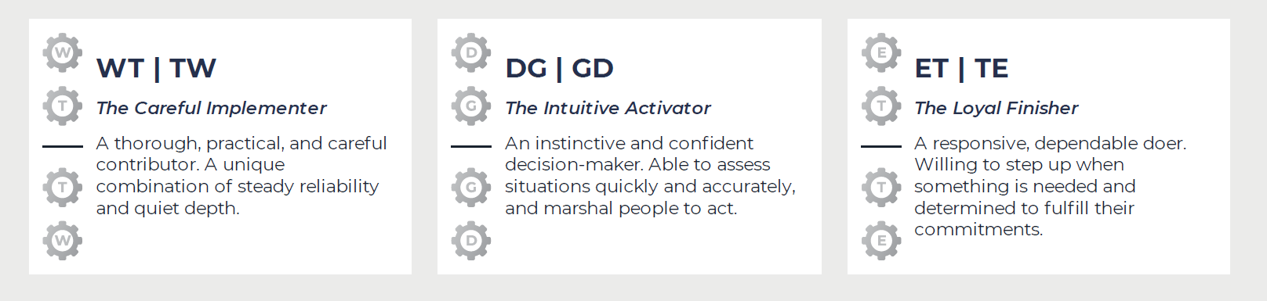
Combining … last but not least
last but not least…

Slide 32
Your company leadership
Wonder
Genius | Frustration
Galvanizing
Genius | Frustration
Invention
Genius | Frustration
Enablement
Genius | Frustration
Discernment
Genius | Frustration
Tenacity
Genius | Frustration

